Slide 1

Case Study
Software Architecture
3rd Year – Semester 1
Assignment – 2

Slide 2
Schedule
28th March – Case Study Distribution
6th April – Topic Registration
Submission of Topic
Finalize Registration of Students for the Groups
7th April to 7th May – Progress Reviews
10th May – Presentation Upload (CourseWeb)
10th May (onwards) – Presentation & Viva 20 marks

Slide 3
What is a Case Study?
An intensive analysis of an individual unit/item/situation
Produce a detailed specialized report (non-generalized)
You'll be conducting qualitative research to find specific details of how your subject is affected
Study outcome may stress factors contributing to its success or failure
Eg: Civilian casualties in 9/11 attack
Notes:
Study outcomes may also include: Recommendations, Observations, Comments, etc…

Slide 4
The Basics
Subject: Choose the situation on which to write
Facts: Gather as much information as possible about the situation
Analyze: Analyze all of the elements surrounding the situation
Evaluate: Determine the final solution implemented
Conclude: Identify why the solution worked or did not work
Notes:
Subject = Topic or Case
Evaluate = Process or Execute
Conclude = Show the strength and weaknesses, etc…

Slide 5
Scope
Narrow down the scope of your case
Eg:
Education
Education in Sri Lanka
Higher Education in Sri Lanka
Private Universities/Institutes in Sri Lanka
… more specific …
Notes:
The Quality of the XYZ course of the ABC institute

Slide 6
Topic Selection
This academic case study is about an intensive analysis about a Software System with respect to its Architecture Style(s) and Key Quality Attribute(s)
E.g. Microservice Architecture used by Facebook and its Scalability & Performance
Software/System → Facebook
Architecture Style(s) → Microservice
Quality Attribute(s) → Scalability & Performance

Slide 7
Topic Selection – Rules
1 topic per group on First come first serve basis
A group should propose only 1 topic at a time and should check if other groups have summitted the same/similar topic
A group should have a Unique topic when the System, Architectural Style(s) and Key Quality Attribute(s) are combined for their study
It’s at the discretion of the Lecture to Approve/Reject the topic if…
Other groups have taken a similar topic
Case/Scope is not compelling enough to conduct a study
Notes:
The Lecturer will provide help for topic selection if needed

Slide 8
Topic Selection – Software System
A Group must select a Software System from one of below categories:
Blockchain Systems
Mobile Messaging
Artificial Intelligence / Machine Leaning
Operating Systems
Examples:
Mobile
Messaging
WhatsApp
AI/ML Systems
Chat GPT
Operating Systems
Linux
Google AI
Open ML
Windows
iOS
Telegram
Facebook Messenger
Blockchain
Ethereum
AWS Track & Trace
NFT

Slide 9
Expectations
Case study should include background information on the specific topic, an analysis of the case under study showing problems or effective strategies, as well as recommendations
Analyze
Why the system was built around the selected Architecture Style?
Why the identified the Quality Attributes are Key to the System success?
How the chosen Architecture Style and Quality Attribute(s) have improved or worsened overall Quality of the System under consideration?
Your findings
What has been done to improve the chosen Quality Attribute(s) of the system
What other Quality Attributes were affected? and how so?
Did the System’s Architecture evolve over time? If so why?
What are the Trade-offs made? What are the implications?
Your judgement/recommendations/suggestions
Compare
Compare with competitor systems in the same domain and identify how the Architectural Style and Quality Attribute(s) under consideration helped to stay competitive (or why this particular system lost out to the others)

Slide 10
Any type of plagiarism is not allowed.
Plagiarism: Academic honesty is crucial to a student’s credibility and self-esteem, and ultimately reflects the values and morals of the Institute as whole. A student may work together with one or a group of students discussing assignment content, identifying relevant references, and debating issues relevant to the subject. Plagiarism occurs when the work of another person, or persons, is used and presented as one’s own.

Slide 11
Registration
4-5 Students per group
Advised to keep the same group as Assignment #1
Exceptions are allowed on case by case basis
Topic
Registration only for 1 topic
In case if the topic is rejected or taken by someone else the group is allowed to register again without an extension for the deadline
Later changes to the topic is highly discouraged and based on availability
Submission of Topics
Only the Group Leaders should submit topics
Submission of topics only allowed via CourseWeb

Slide 12
Viva and Evaluation
Although this is a group assignment, individuals will be assessed on their performance.
Presentation Submission – via CourseWeb
Presentation & Viva
Only the groups who have uploaded the Presentation on time will be allowed for the Presentation & Viva Session
Each member should be present at the Viva/Presentation
A printed copy of the Presentation should be made available during the Viva session
Lecture & Lab timeslots will be taken for the Viva/Presentation

Slide 13
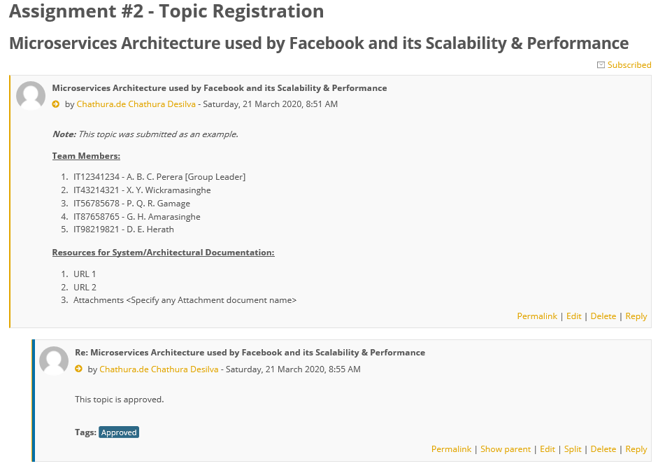
Topic Registration
Create a new Forum Discussion with the Topic
Add details of Team Members
Add Student ID along with Name with Initials
Indicate Group Leader
Provide Resource locations
Official Documentations
White papers
Other research/studies
Lecturer would Approve/Reject the topic
Upon Approval of the topic commence the assignment work

Slide 14
Recommended Reading
http://www.monash.edu.au/lls/llonline/quickrefs/27-case-study.pdf
http://www.wikihow.com/Do-a-Case-Study

Slide 15
Group Presentation Instructions
Plan the presentation for 10 minutes
Limit to a maximum of 20 slides
Every team member must present their work
Include relevant Student ID(s) on each slide
Questions will be asked during the presentation and afterwards if required
Bring a printout of the Presentation to the Viva session

Slide 16
Presentation Outline
Below is a “sample” distribution of Responsibilities among group members:
Member 1:
Introduction (15 seconds), History and most significant changes to the Architecture, Current Architecture, Key strengths, weaknesses, areas to improve with reasons, Key findings & observations, other architectural styles in consideration, etc.
Member 2:
Analysis on Quality Attribute #1, Reasons why its important for chosen system, what methods have been used to improve, relating the knowledge on patterns & tactics, etc., measurements/proof of how quality was improved, Trade-offs made when improving this quality, etc.
Member 3:
Analysis on Quality Attribute #2 – can be the same as Member 2 but for a different quality attribute. Or split the scope of the analysis of 2-3 quality attributes between member 2 & 3 equally
Member 4:
Identification of market needs (current & future), market competitors, what the system need to battle to gain market control (with respect to system qualities), benchmark how the competitors are performing with respect to selected quality attributes, suggestions, recommendations on improvement, alternatives, etc.
References
Include further statistics & references at the end of the slide set. But plan not to present unless Interview panel asks questions on them

Slide 17
<Case Study Topic>
Date: <yyyy-mm-dd>
Group ID : <xxx-xxx-xxx>
Student ID | Name with initials
System : <system name>
Architecture : <architecture style>
Key Qualities: <quality attributes>

Slide 18
Heading
< Student ID >
Content

